Slide 1



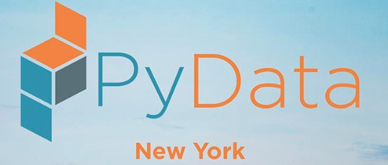
Pandas vs Koalas:
The Ultimate Showdown
Amanda Moran
Solutions Architect, Databricks

Slide 2

Sadly, we won’t be talking about this …
@AmandaK_Data

Slide 3
But we will be talking about DS at Scale ...
… which is just as good!
Introduction to doing Data Science at Scale
A few words on Pandas
What is Apache Spark?
What is Koalas?
Demo
Ultimate Showdown!
@AmandaK_Data

Slide 4



A Little about Amanda …
Solutions Architect @ Databricks
MS Computer Science, BS Biology
Previously: HP, Teradata, DataStax, Esgyn
PMC and Apache Committer on Apache Trafodion
5 Different Distributed Systems
Instructor for Udacity Data Engineering Nanodegree
@AmandaK_Data

Slide 5


Let’s have a Contest!
If you want to win this Koala:
Create a great live tweet on Twitter
Tag me @AmandaK_Data
Use the hashtag
#pydataNYCKoalas
#pyspark
Stick around after the talk
@AmandaK_Data

Slide 6
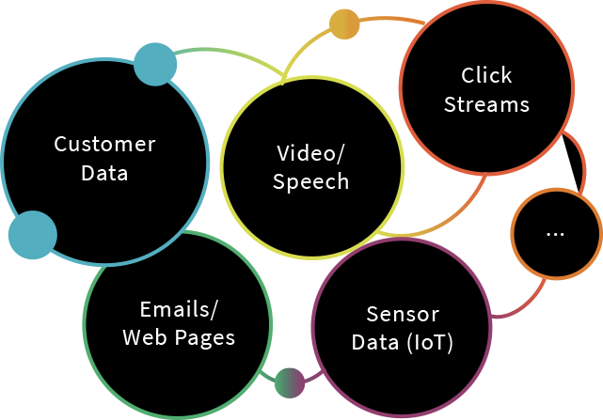
Why Should a Data Scientist Care about Scale?
Huge amounts of data from many sources
Click steam
Customers data
IOT
Video/speech
And this isn’t going away -- only growing
But you are working just fine...
Building models on subsets of data
@AmandaK_Data

Slide 7
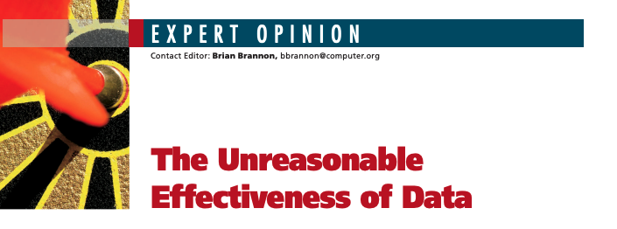
Why Should a Data Scientist Care about Scale?
Large data + simple algorithms = better models
Documented by Google in 2009
White Paper: The Reasonable Effectiveness of Data
@AmandaK_Data
Notes:
Link to Paper: https://static.googleusercontent.com/media/research.google.com/en//pubs/archive/35179.pdf

Slide 8
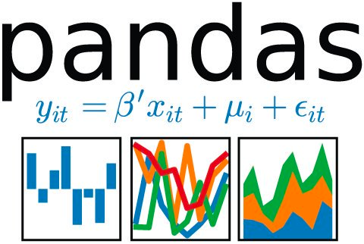
What is Pandas?
Authored by Wes McKinney in 2008
The standard Python tool for data manipulation/analysis
Can deal with a lot of different situations, including:
Basic statistical analysis
Handling missing data
Time series, categorical variables, strings
@AmandaK_Data

Slide 9
Why Pandas?
Easy to start with Pandas
Default choice for teaching
Easy to install and use on any laptop
Easy to write tests with all the python
Huge community
Enormous API for data manipulation
Integration with visualization, ML tools
@AmandaK_Data

Slide 10
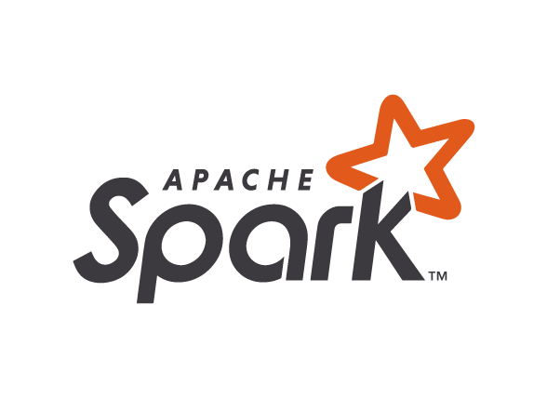
What is Apache Spark?
Open Source
De facto unified analytics engine for large-scale data processing
Streaming
ETL
Machine Learning
PySpark API for Python
API support also for Scale, R, SQL
@AmandaK_Data

Slide 11
Pandas vs Apache Spark
Pandas
Apache Spark
Standard for single machine workloads
Small data
Standard for distributed workloads
Big data
@AmandaK_Data

Slide 12
What’s Wrong with PySpark?
Nothing at all
PySpark is very popular
But integration isn’t seamless
Can’t take the python code you have and run it on Apache Spark
Both have dataframes
@AmandaK_Data

Slide 13
What’s Wrong with PySpark?
Pandas DataFrame vs Spark DataFrame
 | pandas DataFrame | Spark DataFrame
Mutability | Mutable | Immutable
Value count | df[‘col’].value_counts() | df.groupBy(df[‘col’]).count() .orderBy(‘count’, ascending = False)
@AmandaK_Data

Slide 14
Pandas vs PySpark
Pandas
PySpark
import pandas as pd
df = pd.read_csv("my_data.csv")
df.columns = ['x', 'y', 'z1']
df['x2'] = df.x * df.x
df = (spark.read
.option("inferSchema", "true")
.option("comment", True)
.csv("my_data.csv"))
df = df.toDF(‘x’, ‘y’, ‘z1’)
df = df.withColumn(‘x2’, df.x*df.x)
@AmandaK_Data

Slide 15
What is Koalas?
Announced April 24, 2019
Pure Open Source Python library
Aims at providing the pandas API on top of Apache Spark:
Unifies the two ecosystems with a familiar API
Seamless transition between small and large data
@AmandaK_Data

Slide 16
What is good about Koalas?
Be immediately productive with Spark
No learning curve
Have a single codebase that works both with pandas and Apache Spark
One set of tests
Develop on small datasets
Can utilize the power of Apache Spark
Run production jobs on Large datasets
@AmandaK_Data

Slide 17
Pandas vs Koalas
Pandas
Koalas
import pandas as pd
df = pd.read_csv("my_data.csv")
df.columns = ['x', 'y', 'z1']
df['x2'] = df.x * df.x
import databricks.koalas as ks
df = ks.read_csv("my_data.csv")
df.columns = ['x', 'y', 'z1']
df['x2'] = df.x * df.x
@AmandaK_Data

Slide 18
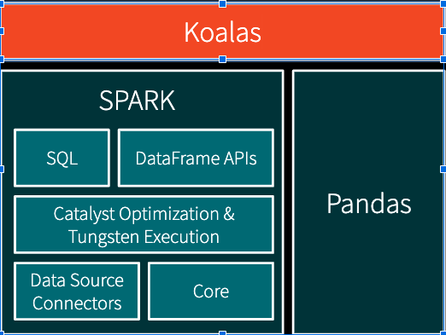
Koalas Architecture
@AmandaK_Data

Slide 19
Demo
@AmandaK_Data

Slide 20

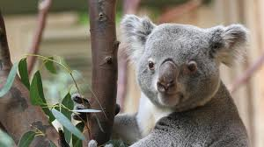
Ultimate Showdown: Who is the Winner?
YOU
More tools to be productive
Koalas for scale
pandas for learning and small data
@AmandaK_Data

Slide 21
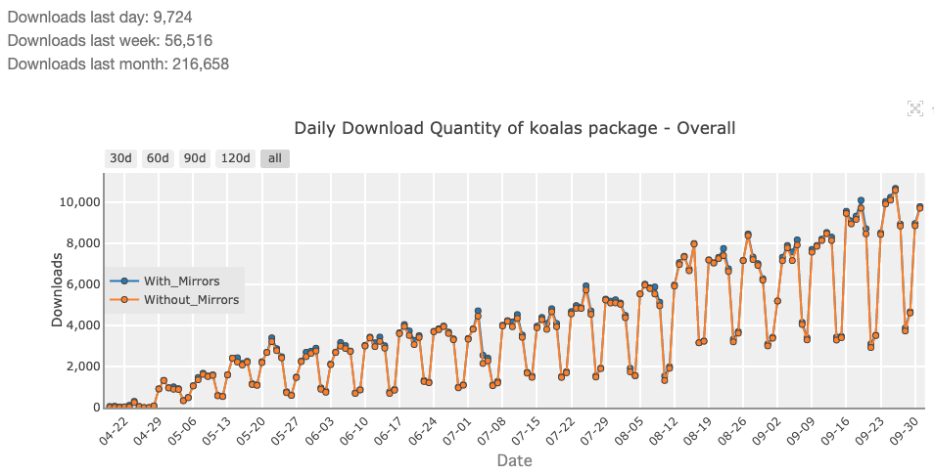
Quickly Gaining Traction
Bi-weekly releases!
> 500 patches merged since announcement
> 20 significant contributors outside of Databricks
> 12K daily downloads
@AmandaK_Data

Slide 22
Status
Bi-weekly releases, very active community with daily changes
The most common functions have been implemented:
60% of the DataFrame / Series API
60% of the DataFrameGroupBy / SeriesGroupBy API
15% of the Index / MultiIndex API
to_datetime, get_dummies, …
@AmandaK_Data

Slide 23
How to Get Started
pip install koalas
conda install koalas
More instructions on https://github.com/databricks/koalas
Documentation
https://koalas.readthedocs.io/en/latest/
Databricks Community Edition:
https://databricks.com/signup/signup-community
@AmandaK_Data

Slide 24
Get Involved!
Contribute to the code
https://github.com/databricks/koalas
@AmandaK_Data

Slide 25

This talk:
Notebooks and Slides
https://github.com/amandamoran/pydatanyc
@AmandaK_Data

Slide 26
Thank you!
@AmandaK_Data

